Slide 1
Engineering Design DSN2096
By:
Ramraj Dangi

Slide 2
Syllabus
Introduction to Engineering design process: Design History; Dieter Rams Principles of Good Design; Overview of Engineering Design Process: Problem Formulation, Concept generation, Project Planning and Design Making; Human Centred Design (HCD);
Design Thinking for Innovation: Design Thinking as Mindset, Process and Toolbox., Enhancing Design Thinking Through, Empathy, Interviewing, Questioning & Brainstorming, Tools for Design Thinking: Mind Mapping, Innovation Flowchart – Question ladder – SCAMPER (for products) Journey Mapping, Task analysis grid (for services)
Engineering Design Approaches: Professional and societal Context of Design; Different types of design – Conceptual, Embodiment designs and Detailed designs – Identification and Specifications, Standards and codes, Design Features – Design for Aesthetics, Production, Standards, Minimum risk, Ease of maintenance, Quality, Minimum cost and Optimum Design, Service Design - People - Asserts - policies - culture. Iterative process - Exploration - Creation - Reflection - Implementation.

Slide 3
Syllabus
Usability & Reliability: Usability – User requirement; User experience; Usability testing; Customer Co-creation; Reliability & Safety: Human and equipment, safety, Risk analysis, and security, System reliability; Use of e-engineering: Modelling, Simulation and Verification.
Prototyping and Visualization: Design Cycle Model, Metaphor method: Theory and methodology of concept generation, Blend method & Thematic Method. Conceptual Design & Design capability and sociality. Prototyping & Visualization Design Tools – E-tools
Sustainable Design: Concepts of sustainable development, Sustainable design principles - Design for Environment; Life Cycle Assessment; Models of sustainable design- Biomimicry, Eco Design, Recycling; Social Innovation
Communication: Articulating design ideas: Storytelling; Sketching & Dynamic Diagrams; K Scripts

Slide 4
Books and resources
TEXT BOOKS:
Huge Jack, “Engineering Design, Planning, and Management” Academic Press, 2013.
Gerhard Pahl, Wolfgang Beitz “Engineering Design: A Systematic Approach” 2014.

Slide 5
Unit5: Prototyping & Visualization

Slide 6
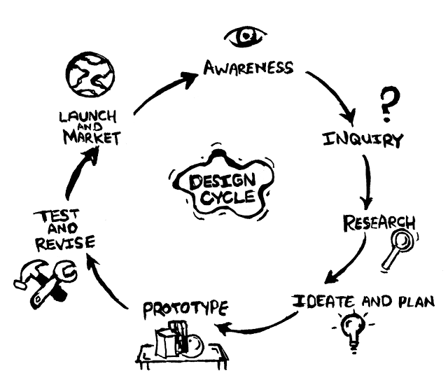
Design Cycle Model
The Design Cycle Model is central to a student’s understanding of design activities.
The DCM comprises of mainly six stages, as follows:
Identifying the needs (Awareness)
Analysing, researching and specifying requirements (Inquiry & Research)
Generating ideas and solutions (Ideate and Plan)
Developing the chosen solution (Prototype)
Realising the chosen solution (Test and Revise)
Testing and evaluating the chosen solution (Launch and Market)

Slide 7
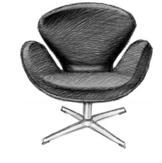
Metaphor Method in Concept generation
A metaphor is a rhetorical figure representing one concept by way of another concept, which is considered similar to the concept to be represented.
Metaphors are often used in design. For example, in the figure shows a famous chair called the Swan Chair. This chair was created by the Danish designer Arne Jacobsen for a hotel, and it remains very popular.
As its name conveys, the Swan Chair is a chair which approximates the shape of a swan in order to convey the quality of a swan (i.e. elegance) and can be represented by the framework for a
metaphor, such as ‘the chair is a swan’.
When we treat design as a process of exploration or when we get together to “bounce ideas off each other” we understand the abstract concepts of design and ideas metaphorically; ideas don’t literally bounce, nor are we literally exploring when we design.

Slide 8
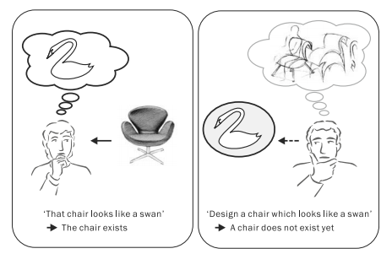
Types of Metaphors
If a person says “that chair looks like a swan”
when he or she looks at the chair, it refers to an existing chair.On the other hand, if a person says this while he or she is designing the chair, then the chair is a concept which does not yet exist.
In this situation, ‘the new chair which is to be designed is a swan’ is a more suitable representation. In such a case, the similarity (implicit common features; e.g. elegant shape) between the chair and a swan play an important role.
On the basis of the above considerations, we can say that, in the design process using metaphors, a new concept will be generated which will be similar to the concept to be assimilated to. A new concept of a chair is generated (referring to a swan or imitating a swan) on the basis of the similarity between the chair to be designed and a swan.
“First order Concept generation”

Slide 9
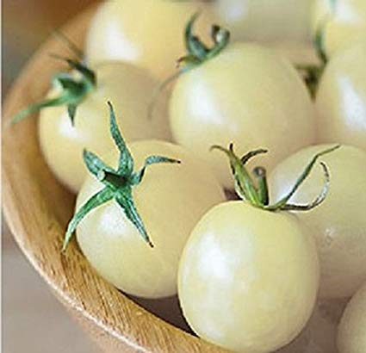
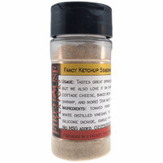
Higher Order Concept Generation
A first-order concept generation is useful only to create a subspecies of an existing object, since it cannot extend beyond the category of the existing product.
Abstract concept generated by combining multiple abstract concepts is called a high-order abstract concept, and the high-order concept generation is the process of generating a new concept on the basis of this high-order abstract concept.
Difference between “White Tomato” and “Powdered Ketchup” is a high-order concept generation is understood to have its basis on the dissimilarity-recognition process.

Slide 10
Higher order concept generation
High-order abstract concepts are classified into two types. Generally, in the relation between concepts, it has been revealed that there are two types of relations—taxonomic and thematic.
The former is a relation that represents a physical resemblance between the concepts, and the latter represents the relation between the concepts through a thematic scene.
With respect to the example of an ‘apple’ and an ‘orange’, the relation which focuses on the shape (round) is a taxonomical relation. On the other hand, with respect to the example of an ‘apple’ and a ‘knife’, the relation which focuses on the scene in which ‘an apple is cut by a knife’ is a thematic relation.

Slide 11
Blending and Thematic Method
High-order abstract concepts can be interpreted as abstract concepts involving an innovative concept which inherits partial properties from both the two base concepts but is different from the two base concepts. We define the concept generation based on this process as concept blending or blending method.
The concept of ‘‘powdered ketchup’’ is an example of concept blending. This new concept is understood to be generated by blending the different properties of snow (abstract concept: snowflake) and tomato (abstract concept: flavouring).
On the other hand, according to the latter relation between the two base concepts, high-order abstract concepts can be interpreted as abstract concepts involving an innovative concept which is generated from the thematic scenes (situations, roles, etc.) of the base concepts. We define the concept generation based on the thematic relation as concept integration in thematic relation

Slide 12
Prototyping Tools for Designer
In simple terms prototyping tools allow designers to experience how their project will work when it will get completed.
There are different types of prototypes tools or UX design tools open source available with different goals and users, means the similar prototyping tool would not work every time.
How to Prefer Best Prototyping Tools that Suit Your Needs?
In order to pick a right tool from the variety of online prototyping tools for designing, here are few factors that will assist you in your research.
Adaptation: Always choose a tool that you can easily analyse and adapt.
Sharing: As we know, teamwork is essential for a great design work, so check your tool is suitable for collaboration to be in sync with other members of your team.
Usage: When selecting a prototyping tool, always check how well it fits with your design process and other tools you regularly use
Easiness of Use and Comfort: The ease of use in using the prototyping tool is essential for the designer to save time and help increase output.
Price: we should be careful while choosing tools and not be blinded by the features.

Slide 13
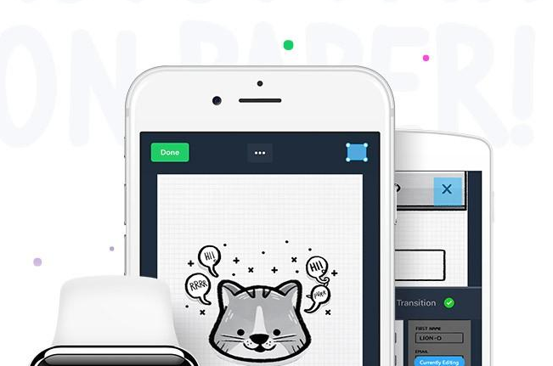
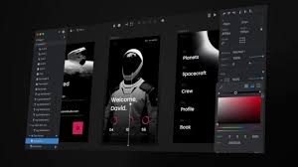
Available E-tools
Marvelapp — Turn anything into interactive prototypes
InVision — Powerful design prototyping tools

Slide 14
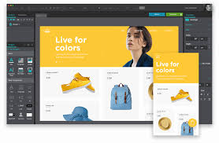
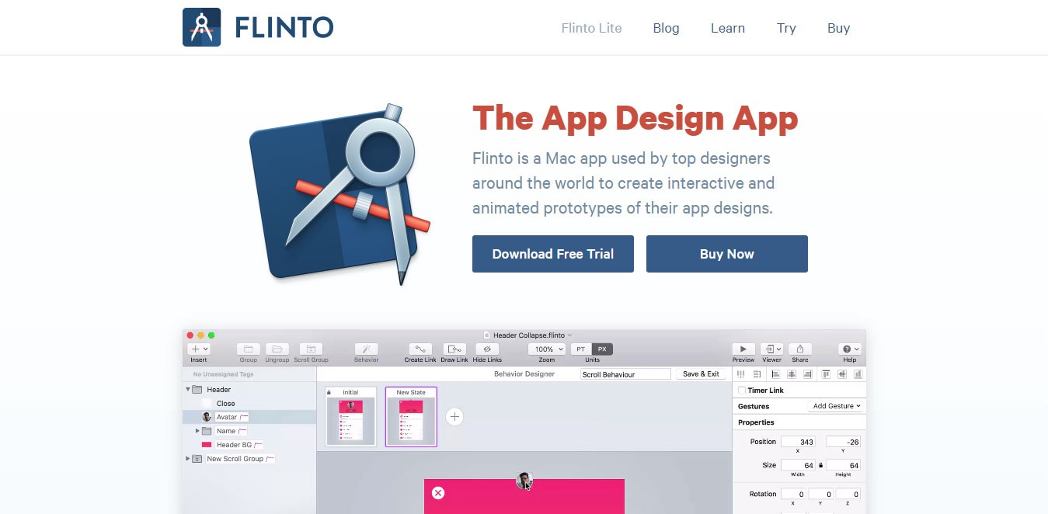
Available E-tools
Justinmind — Prototyping Tool for web and mobile apps
Flinto — The App Design Apps

Slide 15
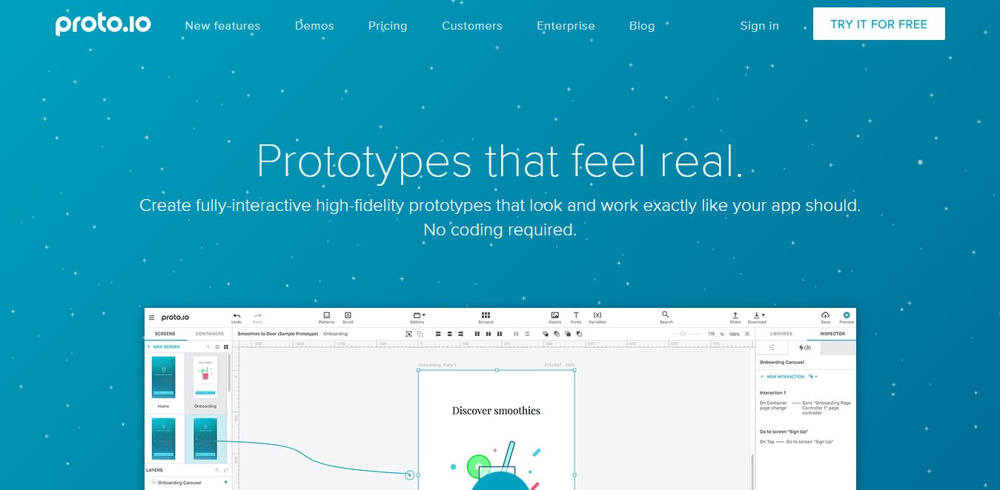
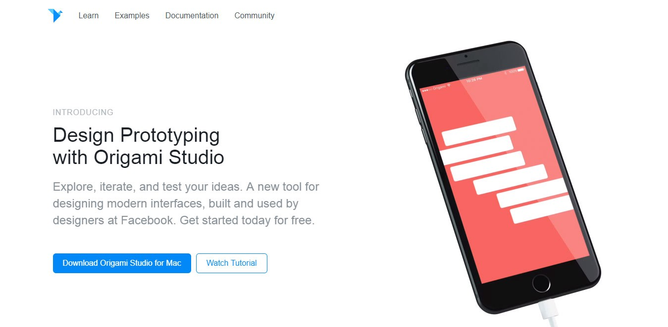
Available E-tools
Proto.io — Prototypes that feel real
Origami.Design — Design Prototyping

Slide 16
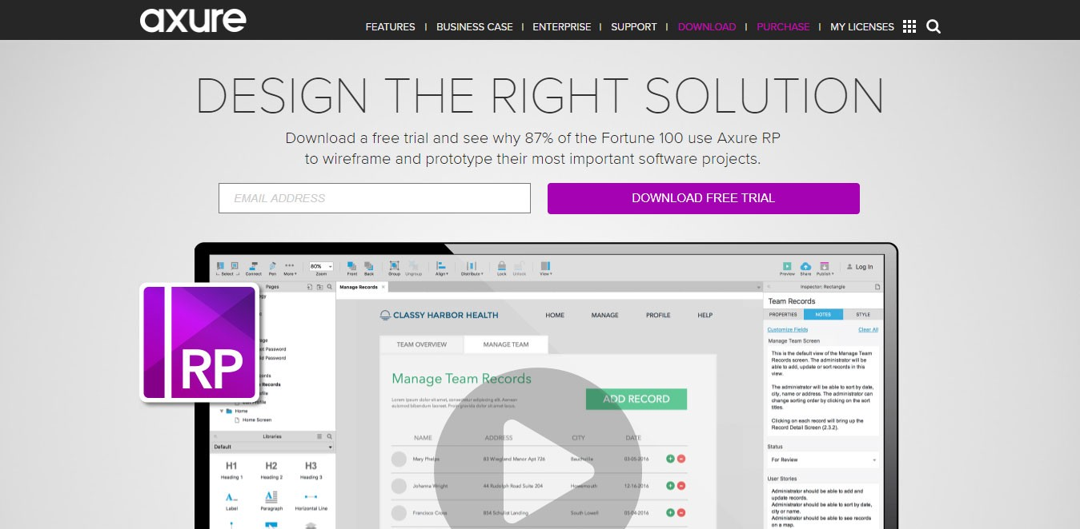
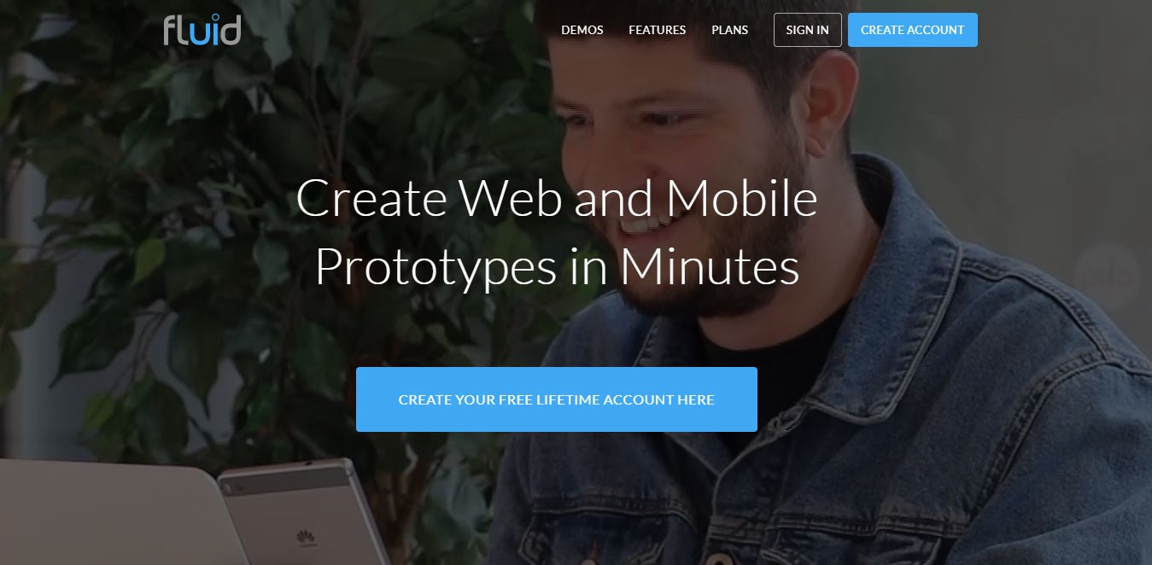
Available E-tools
Axure — Design the right solution
Fluid — Create Web and Mobile Prototypes in Minutes

Slide 17
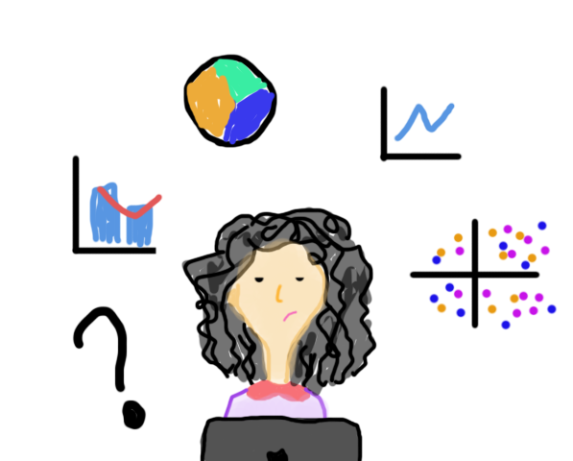
Design Tools for Data Visualization
Adobe Illustrator
SketchApp
Balsamiq
Adobe After Effects
Origami Studio
Adobe Experience Design
Craft
Microsoft PowerPoint

Slide 18
Give description of the above stated prototyping tools for designers?
Assignment 5

Slide 19
Thanks!

